Slide 1

ElectViz
Election Data Visualization For Media
Mentor: Mrs. Nityashree S J
Submitted by: Jyoti Pathak (Team C)

Slide 2

Introduction
ElectViz is an interactive election data visualization project developed as part of our internship. The project focuses on analyzingand presenting large-scale Indian election data using Power BI to uncover meaningful patterns and trends.
The primary objective of ElectViz is to transform complex election datasets into clear, intuitive, and visually engaging dashboards.
By combining data analytics with effective visualization techniques, the project demonstrates how data-driven insights can enhance political reporting and support informed interpretation of election outcomes.

Slide 3




System Design And Workflow
01
04
Data Collection
Data Modeling
Historical Indian general election dataset containing state, year, constituency, candidate, party, votes, and elector details collected from Kaggle.
Establishing relationships between fields such as State, Year, Party, and Constituency
02
05
Data Preprocessing
Data Visualization
Data cleaning and transformation performed in Power BI Power Query where we Handled missing values, standardized party names, and formatted data types.
Designing interactive dashboards using charts, tables, maps, slicers, and KPIs while implementing filters and drill-through features for detailed analysis.
03
06
Creation of custom columns
Insight Generation
Added Region (North, South, East, West) and Voter Turnout Percentage (Votes Polled / Electors × 100)
Identification of voting trends, party dominance, gender participation, and regional performance.

Slide 4




Future Enhancements
Integrate sentiment or public opinion data
AI-powered insight generation
Implement AI-powered insight generation to automatically highlight key patterns, anomalies, and significant changes in election outcomes.
Integrate sentiment or public opinion data to correlate voter behavior with social and political narratives.
Real-time and post-election data
Enabling deeper drill-down
Extend the project to include real-time and post-election data integration, enabling timely analysis and live election monitoring.
Improve interactivity by enabling deeper drill-down capabilities from national-level summaries to state, constituency, and candidate-level insights.

Slide 5
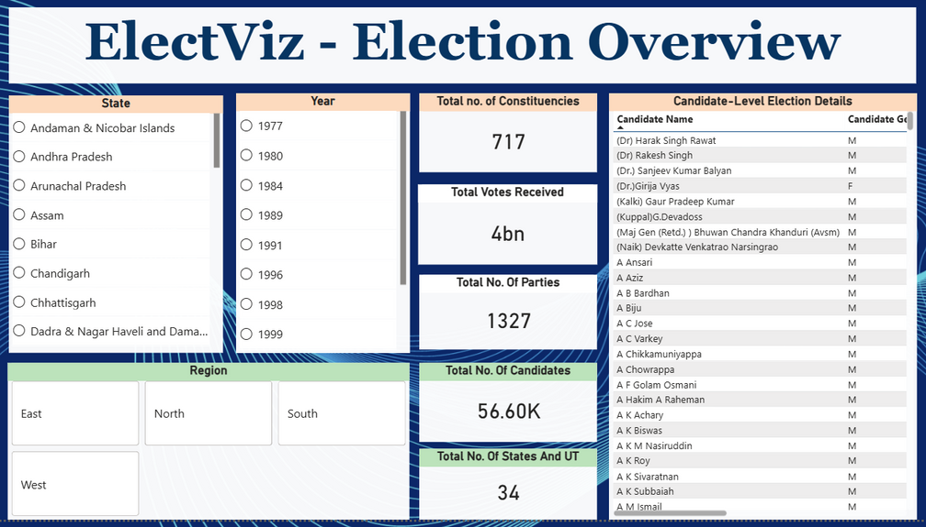
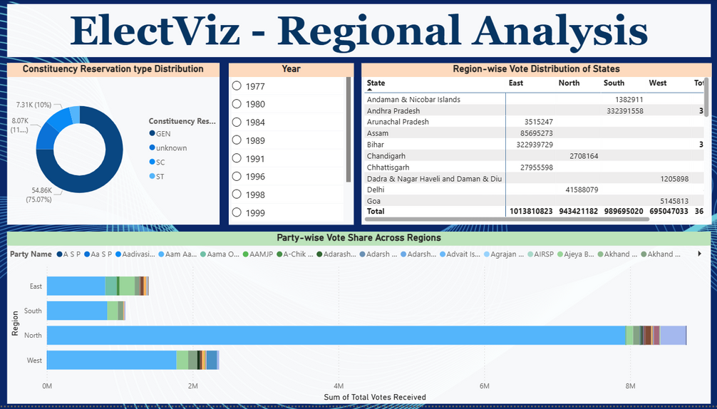
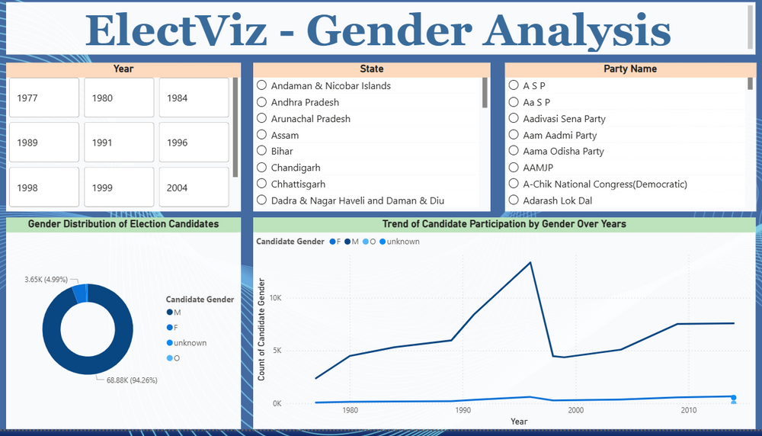
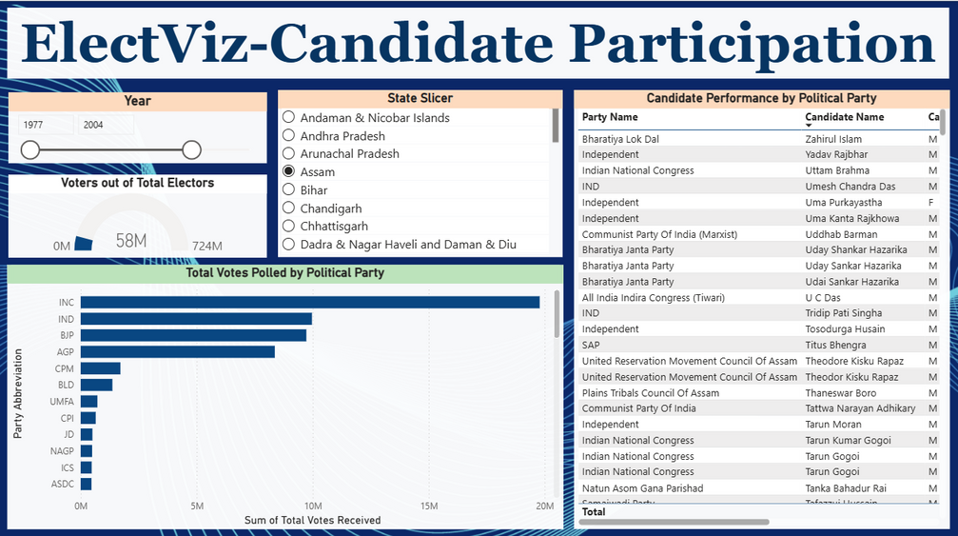
Snapshots

Slide 6
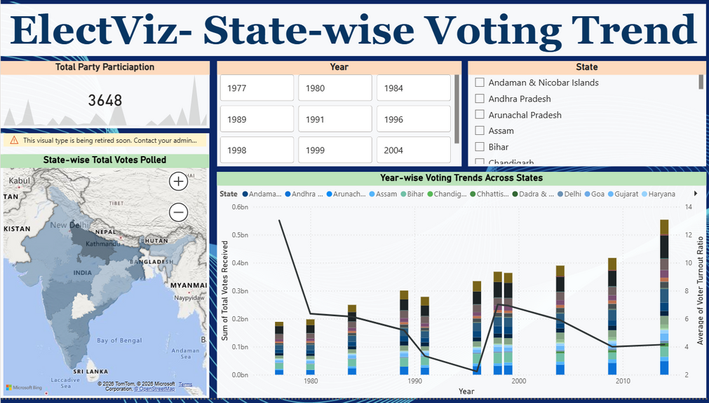
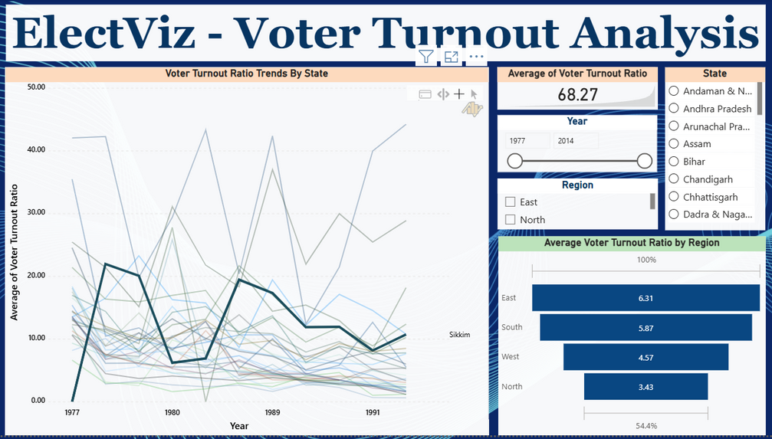
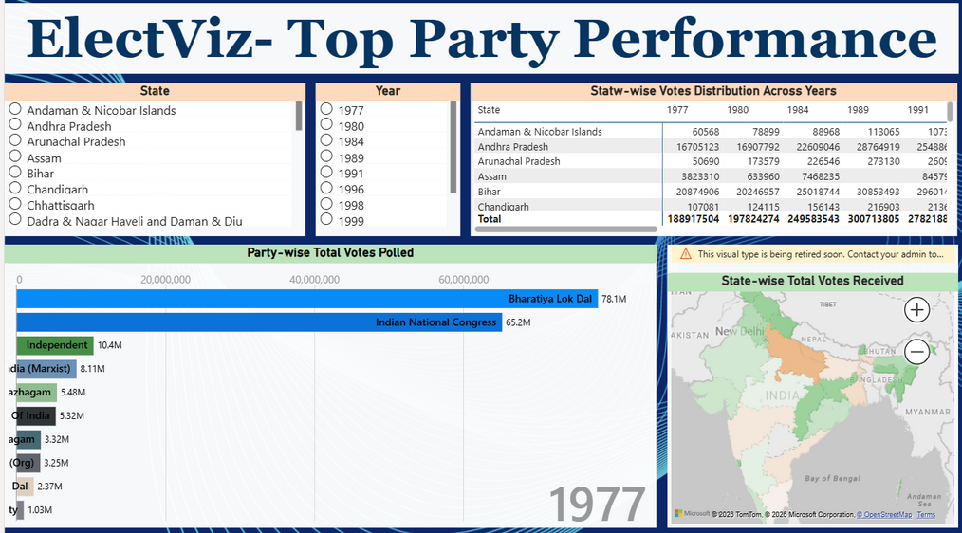


Snapshots

Slide 7


Conclusion
The ElectViz: Election Data Visualization for Media project successfully demonstrates how data analytics and visualization can convert complex election datasets into meaningful and actionable insights. By leveraging Power BI, the project transforms large-scale Indian election data into interactive dashboards.
Overall, ElectViz enhances political reporting by enabling fact-based storytelling and informed interpretation of election outcomes. It lays a strong foundation for future extensions such as real-time election tracking and predictive analysis.

Slide 8

Thank You

